Slide 1
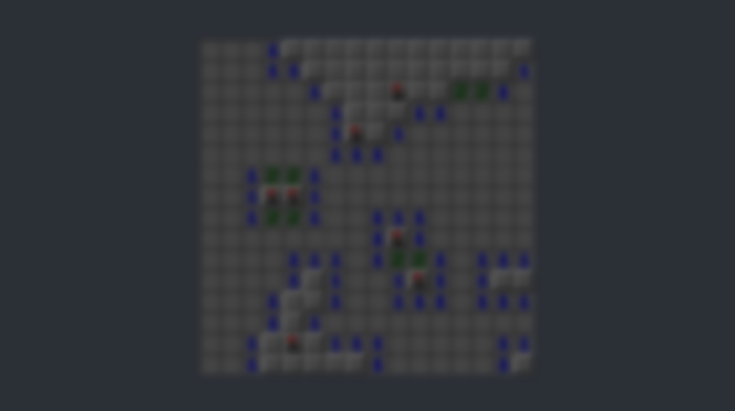
Script map
Spel logiken
Uppdatera det grafiska på spelplanen
Hålla data om rutans(cellens) tillstånd.
Ansvar:
Script:
Game Manager
Board
Cell
Start Game
Draw board
Cell Data
CreateBoard with cell data
Get tileData to se what state tile have.
Player Clicks a tile
Preform action
Av Bengt-Erik Ingvaldsson 2022-11-12

Slide 2
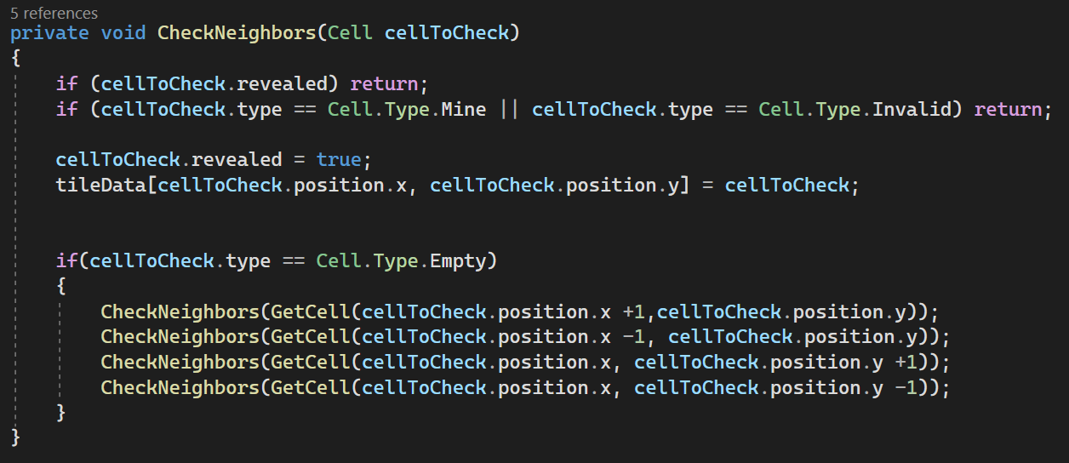
Close look on how to CheckNeighbors() work.
(work assignemnt task)
Av Bengt-Erik Ingvaldsson 2022-11-12

Slide 3
CheckNeighbors(Cell cellToCheck):
This function take a ”Cell” parameter. This parameter are the cell we want to check. We start by checking the tile player
Click. If that is not a mine or invalid tile then script continue to check right ,left ,up and down. Not diagonally because this
Would protanomaly make it possible to click once and all ”empty” tiles would reveal.
And this tile.
3
Tile to check next.
Tile to check.
Also start check on this tile.
1
2
4
And this tile.
Av Bengt-Erik Ingvaldsson 2022-11-12

Slide 4
CheckNeighbors(Cell cellToCheck):
This loop are active until one of this conditions are met:
-A cell is a mine.
-Cell are outside tileMap/Board.
-Cell must be empty.
Board border
Not empty = No check
2
3
If this is a mine. Check are not called on this tile
Tile to check.
If this tile are outside map. No check are called
1
2
4
Already checked : No new check called
Av Bengt-Erik Ingvaldsson 2022-11-12

Slide 5
And this loop runs wild on the board until there are no more tiles that meet this requirements.
Thank you for letting me do this fun and exciting assignment. I learn allot and I hope this is what you had in mind.
Please let me know if you have any more questions about the code or anything on bengt.erik.ingvaldsson@gmail.com
Av Bengt-Erik Ingvaldsson 2022-11-12

